Slide 1


System Analysis And Design (SAD)
Smita Bisht
Assistant Professor
School of Polytechnic

Slide 2
DATA FLOW DIAGRAM(DFD)
Data flow diagram is one of the structured analysis techniques.
It shows the flow of data between various functions of system and specifies how the current system is implemented.
It is an initial stage of design phase
Its graphical nature makes it a good communication tool between user and analyst or analyst and system designer.

Slide 3
A data flow diagram (DFD) maps out the flow of information for any process or system.
DFD is a graphical representation of the system which provides a more complete, clear and global understanding of the system under investigation.
It gives an overview of what data a system processes, what transformations are performed, what data are stored, what results are produced and where they flow.

Slide 4
DFD SYMBOLS
RECTANGLE- A square defines a source(originator) or destination of system data.
ARROW- An arrow identifies data flow(data in motion). It is a pipeline through which information flow.
CIRCLE- A circle or a bubble represents a process that transforms incoming data flow(s) into outgoing data flow(s).
OPEN RECTANGLE- An open rectangle is a data store, sometimes called files or databases.

Slide 5
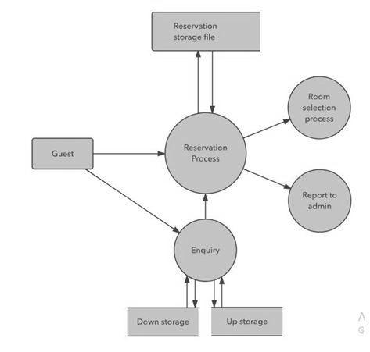

Slide 6
DATA DICTIONARY
A data dictionary is a collection of descriptions of the data objects or items in a data model for the benefit of programmers and others
It stores the descriptions of all DFD data elements that is, details and definitions of data flows, data stores, data stored in data stores, and the processes.
A data dictionary improves the communication between the analyst and the user.

Slide 7
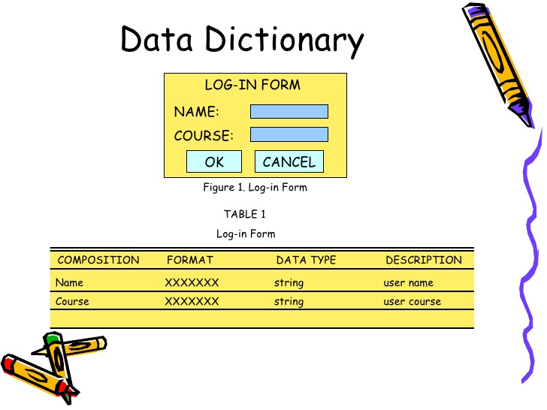

Slide 8
DECISION TREES
A decision tree is a decision support tool that uses a tree-like graph or model of decisions and their possible consequences, including chance event outcomes, resource costs
A decision tree is a graphical technique that shows a decision situation as a linked series of nodes and branches.
Nodes and Branches are used by Decision Trees.

Slide 9
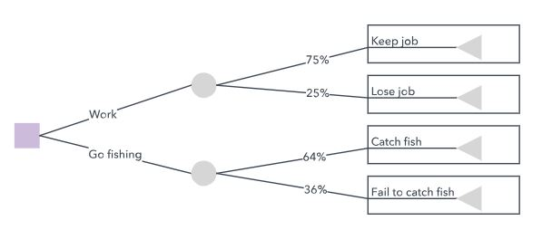
A decision tree typically starts with a single node, which branches into possible outcomes. Each of those outcomes leads to additional nodes.

Slide 10
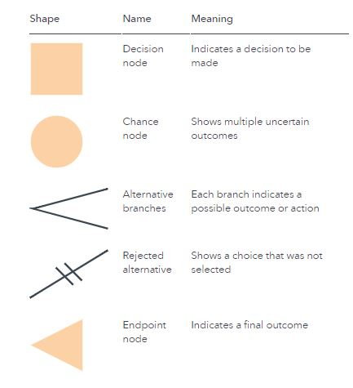

Slide 11
DECISION TABLE
Decision tables are a method of describing the complex logical relationship in a precise manner which is easily understandable.
It is useful in situations where the resulting actions depend on the occurrence of one or several combinations of independent conditions.
It is a matrix containing row or columns for defining a problem and the actions.

Slide 12
The decision table is divided into two parts:
1) Condition- The condition part specifies all conditions that are applied to the input data.
2) Action- Its describes the action to be taken to meet each condition.

Slide 13
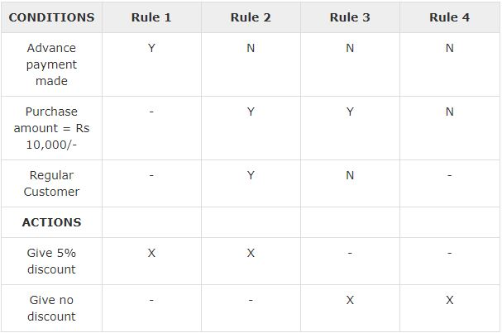

Slide 14
Q) An insurance company uses the following rule to determine the eligibility of a driver for insurance.
The driver will be insured if:-
1. The driver lives in the city with population less than 5000 and he is married man.
2. The driver lives in the city with population less than 5000 and he is married and age is over 30 years old.
3. The driver lives in the city with population is 5000 or more and it is married female.
4. The driver is male over 30.
5. The driver is married and under 30.

Slide 15
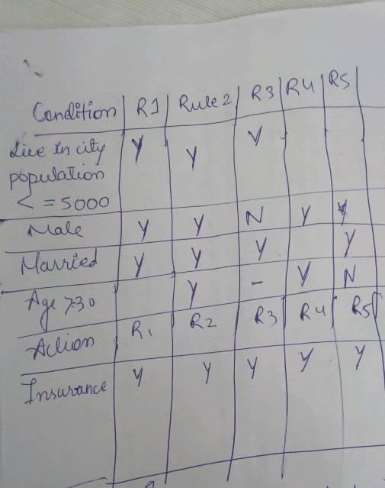

Slide 16
1) If product code=A
And customer type=1
And the order amount<=700
Then 5% discount allowed
2) If product code=A
And customer type=2
And the order amount<=700
Then 7.5% discount allowed
3) If product code=A
And customer type=1
And the order amount>=700
Then 7.5% discount allowed
4) If product code=A
And customer type=2
And the order amount>700
Then 10% discount allowed

Slide 17
